Slide 1
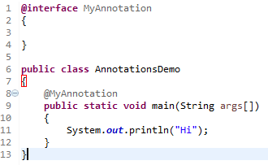
Java Custom Annotation
Java Custom annotations or Java User-defined annotations are easy to create and use. The @interface element is used to declare an annotation.
In this example , MyAnnotation is the custom annotation name.
Points to remember for java custom annotation signature
Method should not have any throws clauses.
Method should return one of the following: primitive data types, String, Class, enum or array of these data types.
Method should not have any parameter.
We should attach @ just before interface keyword to define annotation.
It may assign a default value to the method.

